Slide 1
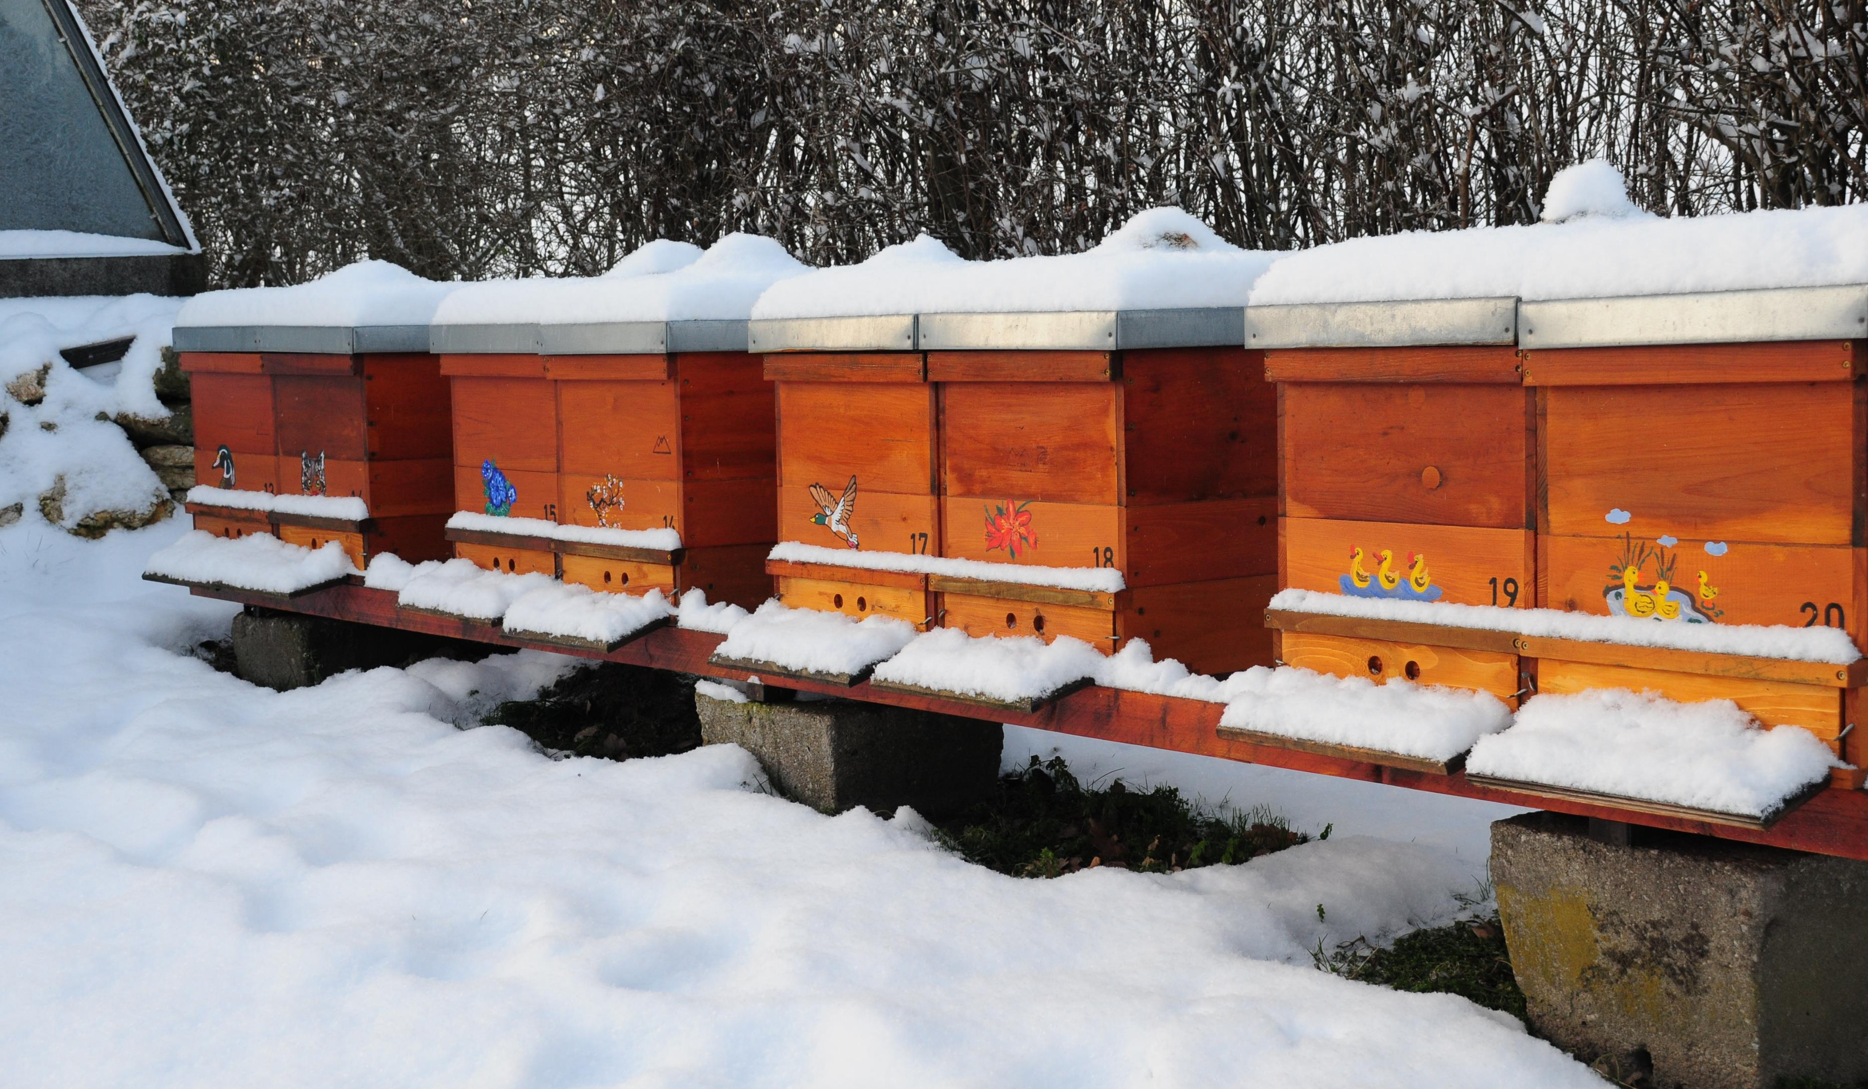
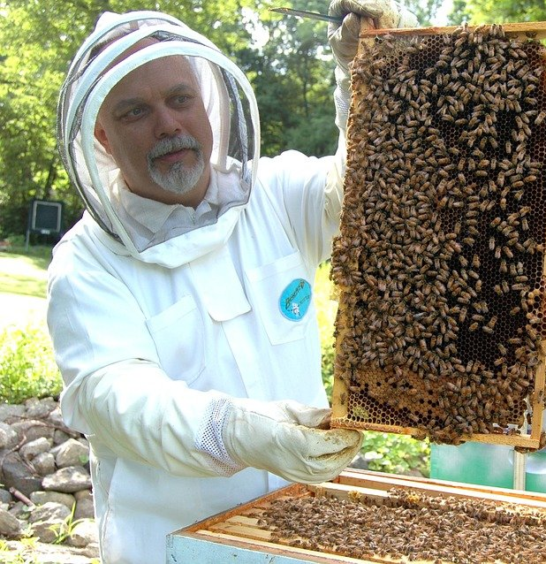
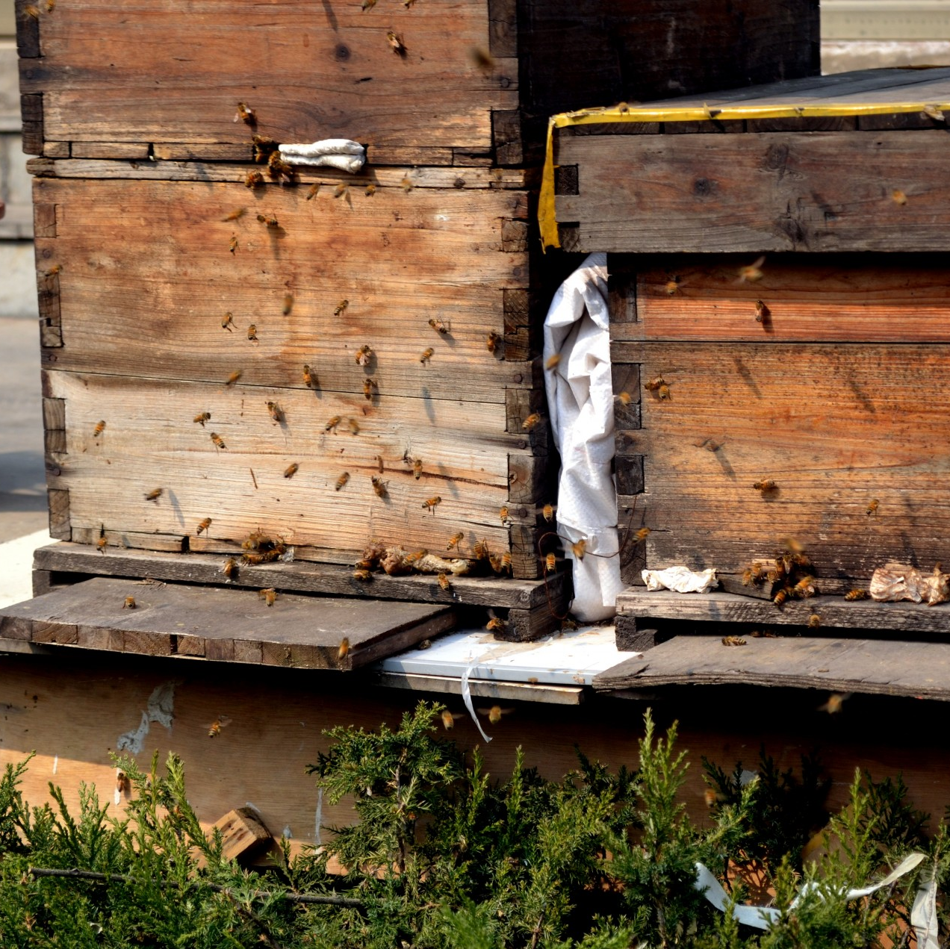
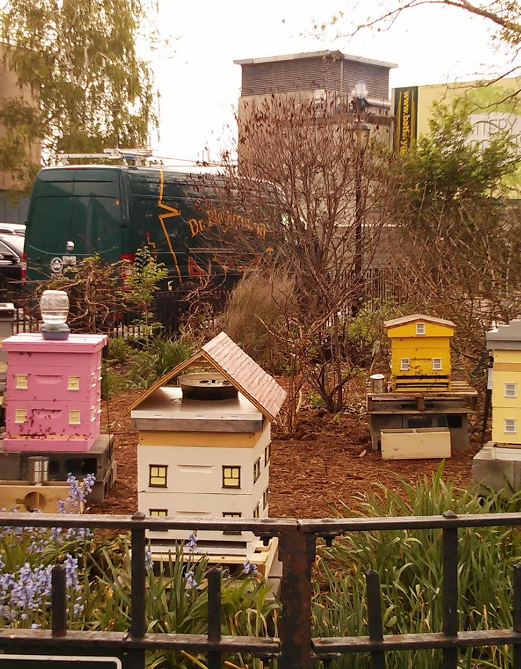
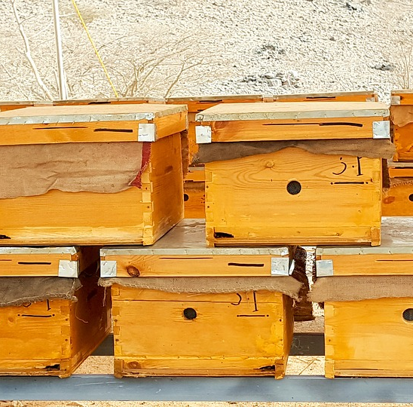
Module 2
Session 7
This Photo by Unknown Author is licensed under CC BY-NC-ND

Slide 2
Revision !
Honey absorbs water from the atmosphere. What is this reaction called?
What type of extractor is used for Ling heather?
How many ovaries does an apple flower have?
Name a factor that can affect nectar secretion in a plant?
Name two contaminants that might be found in a sample of honeydew not found in blossom honey.
What is the latin name for Osr?

Slide 3

7. Why does OSR crystallise so quickly?
8. What is the maximum permitted percentage of water in heather honeyfor retail in the UK?
9.Give one disadvantage of using a tangential honey extractor.
10. What is an entomophilous plant or flower?
Draw and label a flower diagram with 8 labels.
List 6 things affecting nectar secretion.

Slide 4
2.6 The storage of honey including the underlying principles of storage
Buckets must be food grade plastic
Granulate at different rates according to its sugar content
Ferments if stored at 20-30˚

Slide 5
Solid stored honey for jars | 120 | 49 | 24hrs
Blending two types | 100 | 38 | Until uniform temp.
Warming granulated for soft set | 90 | 32 | 2-3 days
Removing from comb granulated | 125 | 52 | Until removed
Heather honey for filtration | 120 | 49 | As required to reach uniform temp.
Liquefy course grained for seeding. | 150 | 66 | Until liquid- watch closely

Slide 6
Time for 30mg/kg HMF to accumulate (BBJ Aug 2012)
30 ˚ | 100-300 days | Honey held at ambient 30˚C for 6mnths accumulates more HMF than that flash heated to 70˚C for 5mins and cooled
40 ˚ | 20-50 days
50 ˚ | 4-10 days
60 ˚ | 1-2.5 days
70 ˚ | 3-5 hours
80 ˚ | ≤ 2 hours

Slide 7
2.7 The preparation and bottling of liquid honey including ling heather honey
High fructose : glucose granulate slowly opposite eg rape faster
High viscosity granulates slower
Crystals form around nuclei – pollen/crystals/dust/ bee bits
Speed of granulation influences crystal size.
Heather honey has high protein and water content
Overheating loses aroma and thixotropic quality
NB Erica is not thixotropic
Microwaves

