Slide 1
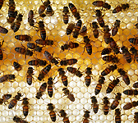
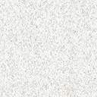
Constituents and Properties of Beeswax

Slide 2
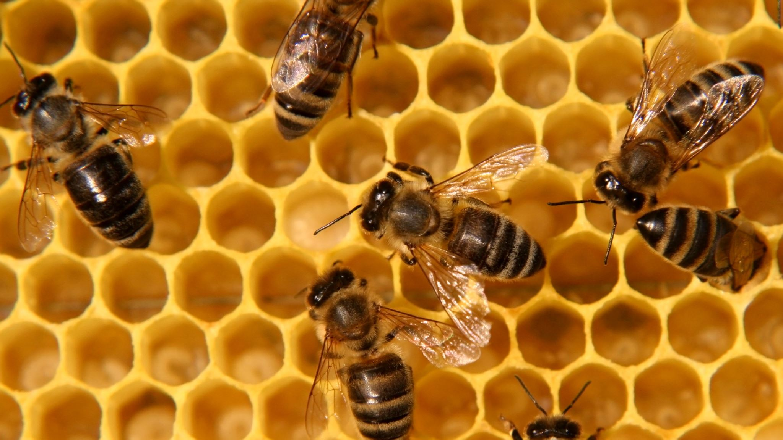
What is it ?
All insects produce wax, it is part of the cuticle providing waterproofing to the insect.
Bees produce more than any other insect. Its composition is not consistent, depending on the sub-species of bee, the age of the wax, the climate whilst it was being produced.
The variation occurs mainly in the relative quantity of components rather than its actual chemical identity

Slide 3
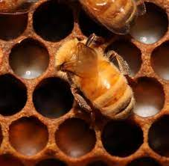
Who makes it ?
Beeswax is produced by the young bees 12 to 20 days old. The peak of wax production is at 16 to 18 days. Bees at this age are well fed while on their hive duties.
Bees collected from a swarm are energetic wax makers, they need a warm temperature about 35°C when they hang in clumps whilst producing the wax

Slide 4
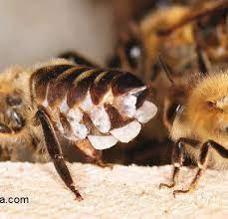
How do the bees produce it ?
Bees consume nectar and honey with a little pollen to produce wax, in their abdomens in segments 4 to 7, the building blocks pass through gaps between four pairs of thickened cells of wax glands called benocytes cells to make lipoproteins, this then moves to the outside of the body through openings in a membrane called a “wax mirror”. Once outside of the body the wax hardens and forms a transparent flake which quickly whitens. This flake is removed by the bees back legs then passed to the mandibles where it's worked and shaped as needed

Slide 5
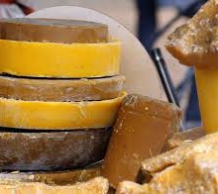
Appearance
The new wax when drawn into a comb is a whitish colour, after manipulation it yellows from pollen it picks up. When it's used In brood comb cells the larval stages and their waste products cause the comb to darken to brown and then black
Making wax uses lots of nectar and honey and a little pollen for protein.
Whitcombs 1946 experiment suggested that 6.6 to 8.8 kilogrammes of honey yielded 1Kg of wax, the BBKA Guide suggests 5 litres of honey were consumed to make a Standard National frame of comb

Slide 6
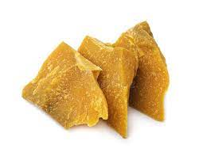
Physical Properties
Although beeswax iproperties aren’t uniform it contains about 300 different organic compounds
Melting point is 63.8 °C
Solidifies at 63 °C
Flashpoint 242-250°C
Workable 32-35 °C
Specific Gravity 0.95
Density 0.963 - less dense than water
It's brittle when cold and the fracture is dry and granular odour honey like
Plastic at 30-35°C
Reacts with air at room temperature to produce a whitish bloom which has a crystalline structure and has a melting point of 38.8°C
Reacts with alkalis to form by saponification, soap, hard water (which contains calcium salts) will react with beeswax to make soap
Insoluble in water, slightly soluble in alcohol and completely soluble in mineral, vegetable oils and other organic solvents
When liquid wax solidifies it shrinks 10%

Slide 7
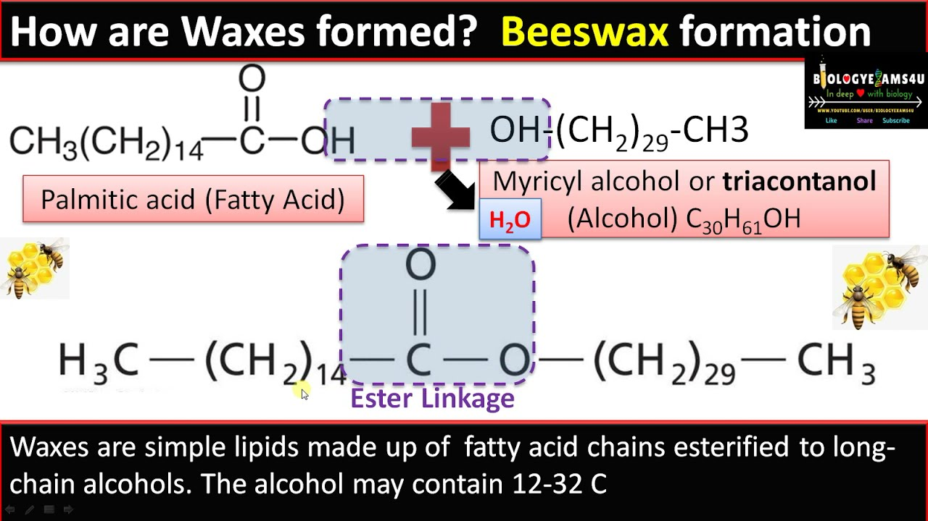
What is Beeswax?
Beeswax is mainly a hydrocarbon, long repeating chains of Hydrogen and Carbon atoms joined together, there's about 300 different organic chemicals in beeswax
As the chains get longer the compound becomes more solid
When hydrocarbons contain oxygen then they are acids and alcohols
when acids and alcohols react they form esters
Hydrocarbons 14 %
Acids 12 %
Esters 60 %
Average Chemical Properties
Hydrocarbons 16%
Monohydric Alcohols -Myricil alcohol 31%
Diols -Cerotic acid 3%
Fatty Acids 31%
Hydroxy acids 13%
Others, Plant Pigments Propolis, Pollen 6%

Slide 8
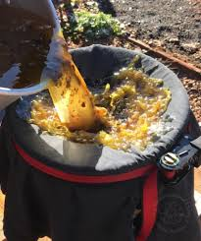
Preparation of Beeswax
The wax garnered from cappings removed by the bees gives the cleanest beeswax for competition entry and when filtered with fine muslin and cooled very slowly to allow air bubbles to release will form blocks of very pure wax
Wax resulting from hive manipulations melted by a flameless heat and strained can be part exchanged for new foundation
Beeswax can be collected and purified by hot water extraction or steam extraction
Commercial rendering and filtration of beeswax can remove pollen and some of the discoloration from old brood comb wax
Beeswax can be contaminated with Paenibacillus larvae ( causes American Foulbrood) these spores can only be killed by heating to 120°C for 30 mins under pressure of 1400hPa(1.4Bar), acarides( from pesticides) naphthalene and benzene (hydrocarbons)

Slide 9
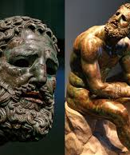
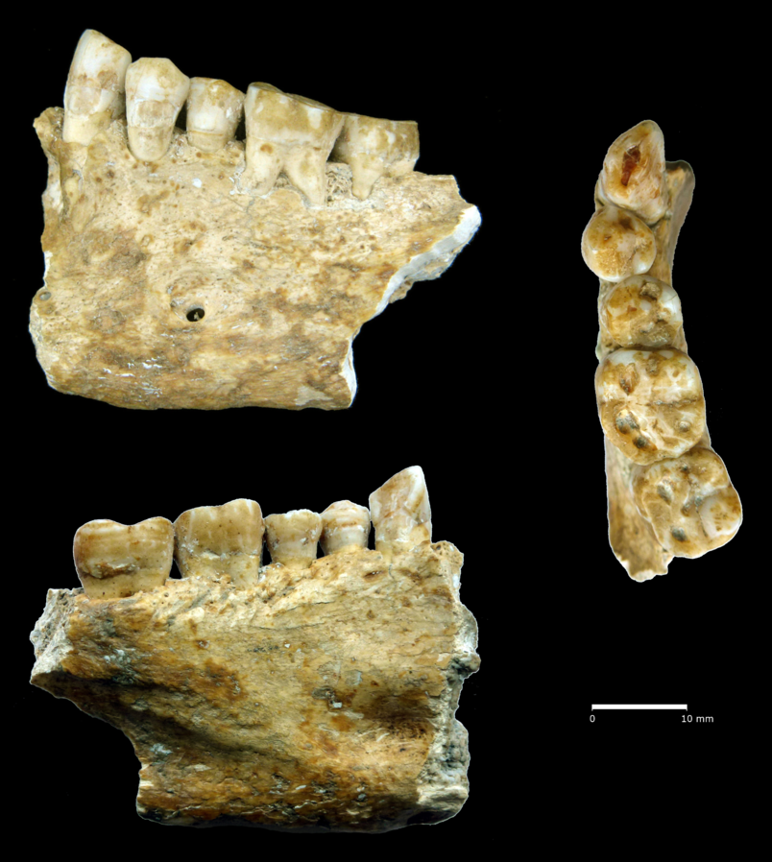
Uses of Beeswax
Few mammals can digest beeswax, the Bushman of the Kalahari (San People) are rare to have enzymes in their gut which can digest beeswax
Beeswax is one of the earliest plastics used by mankind and has been used by Neolithic humans as dental fillings
it was used by the Egyptians for encaustic painting on their mummies
The Romans used it as a surface on wax tablets with which to write on
For sealing sewing thread and cordage also for waxing moustaches.
It is used to control bleeding in bone surgery and as a resist in batik
When it is mixed with pine rosin it makes a strong glue, often used in squeezeboxes
Cheeses can be coated in it
Most ancient bronzes were made using Lost Wax Casting method of modelling and casting
It’s E number is E901

Slide 10
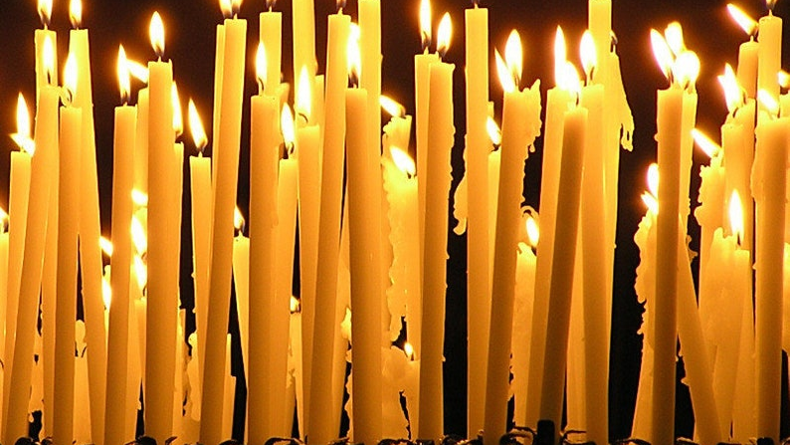
Candles
Candles have been made from beeswax for thousands of years, it burns cleanly and as the wax has a high melting point it burns brightly and slowly
It's usually mixed with paraffin wax (48-68°C melting point) as its melting point is higher ( 63.8°C) so candles burn brighter with a beautiful warm glow.
Beeswax/paraffin wax mix candles are more resistant to warping and are much cheaper to produce .
In 1517 Henry VIII paid 43 shillings for his Kings Candle at Walsingham- that’s between £1700 and £15600 now (depending on calculation methods) this would have been a pure bees wax candle.

