Slide 1
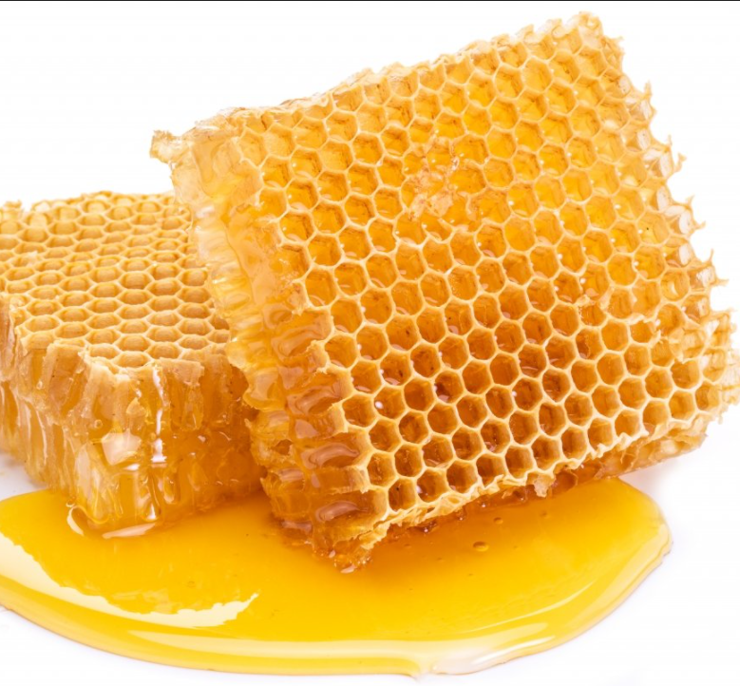
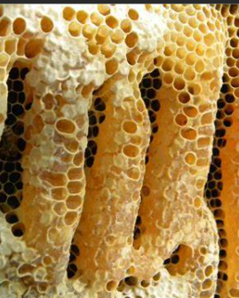
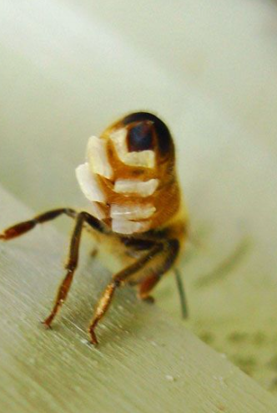
Module 2
Session 10

Slide 2
NOV 2017
Q1 What does a beekeeper use a refractometer for? ………………………………………………………….
Q2 How will a clover flower indicate that it has been pollinated? …………………………………………………………………………
Q3 What is metheglin? …………………………………………………………………………………………….
Q4 Name two types of honey extractor. …………………………………………………………………………
Q5 What sort of plastic should honey storage buckets be made of? …………………………………………………………………………
Q6 Name a factor which can affect nectar secretion in a plant. ………………………………………………
Q7 What is the maximum permissible water content for heather (Calluna) honey? ………………………………………………………………...
Q8 In what does a worker bee transport pollen back to the hive? ……………………………………………
Q9 What does the Schade scale measure? …………………………………………………………………….
Q10 What is the name given to the black dross that is produced when the wax from used frames is melted? …………………………………………………….

Slide 3
List the characteristics of honey bees and honey bee colonies which make them good pollinators. 6
(b) Distinguish between pollination and fertilisation. 2
(c) How do each of the flowers of forget-me-not, horse chestnut and clover indicate to bees that, having been successfully pollinated, their visits are no longer required? 3
(d) What are nectar guides and what is the significance of the spectrum of vision of honey bees? 4
Q11 March 2016

Slide 4
Physical Properties of Honey
Specific Gravity
Varies with sugar content but is affected by temperature. Easier to use a hydrometer
Refractive Index:
Use of the refractometer
Electrical Conductivity:
indicator of botanical origin:-
Blossom and blossom and honeydew should have less than 0.8mS/cm
Honeydew and Chestnut more than 0.8mS/cm . Directly related to ash content
Some exceptions – Erica, Leptospermum, Tilia
Relative Density:
Measures sugar content / honey fraud

Slide 5
Viscosity: A measure of the resistance to flow
- reduces as temperature increases
- reduces as moisture increases
- important influence in handling
Hygroscopicity:
- implications for processing and storage
Reaction to Heat:
- ease of processing
- dissolve crystallised honey
- kill yeasts
Overheating - HMF raised
- enzyme activity reduces
- loss of volatile oils / aroma
- darkening

Slide 6
The Physical Properties of Honey
2017
Q13 In relation to honey, write short notes on:
(a) viscosity; 4
(b) specific gravity; 5
(c) electrical conductivity. 6

Slide 7
The Main Constituents and Physical Properties of Beeswax
Varies: depends on the bees, weather and time of year
Made of: myricyl palmitate – a chemical ester
4 main ingredients:-
Esters 70%
Alcohols 1%
Acids 10%
Hydrocarbons 13%

Slide 8
Physical Properties of Beeswax
Solubility
- insoluble in water
- slightly soluble in alcohol
-soluble in ether, chloroform, benzene
Colour
- colourless as flakes white as solidifies
Temperature
- melts 62 ˚ =64 ˚
- pliable 32 ˚ - 35 ˚
- flashpoint 242 ˚ - 250 ˚
Relative Density - 0.96
Acidity -20
Reactivity
- reacts with alkalis and hard water, saponification

Slide 9
Q14 (a) List the physical properties of beeswax. 5
(b) Outline how the wax from used combs and clean cappings can be recovered. 7
(c) List 3 uses of beeswax. 3
March 17
Q14 (a) List 5 physical properties of beeswax, giving values where appropriate. 5
(b) Describe briefly the process of recovering beeswax and usable honey from 10kg of wet cappings. The honey ending up in a bucket and the beeswax made into blocks suitable for exchange into sheets of foundation. Include temperatures in ˚C and approximate time durations. 10
NOV 16

